Slide 1
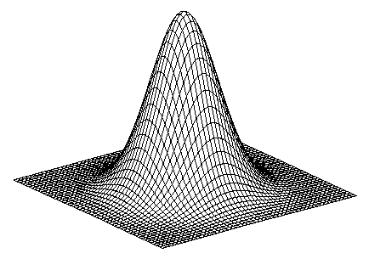
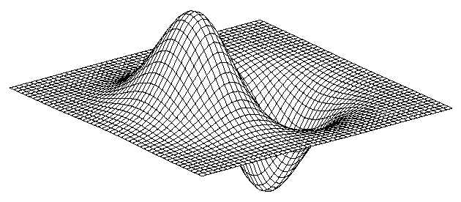
Review
Edge detections
  What is edge
  Detect edges using derivatives
  Smoothing
Derivatives of Gaussian (DOG)
Canny detector
  DOG filtering
  NMS
  Thresholding & Linking
PB boundary detector

Slide 2
Today’s class
Finding a line

Slide 3

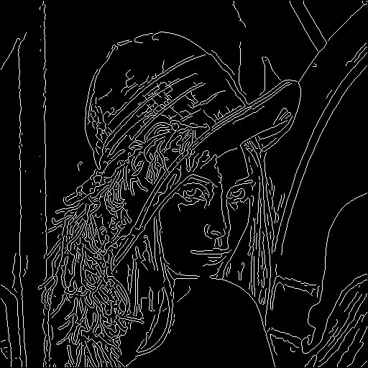
Find a line in edge map is difficult

Slide 4
Robust fitting problem
Fit a set of edge segments with one single line;
Threshold based Edge-link method doesn’t work.

Slide 5
Simpler cases
Which line is the best?

Slide 6
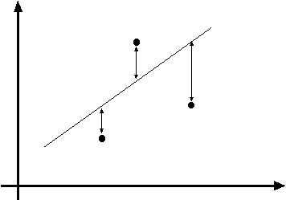
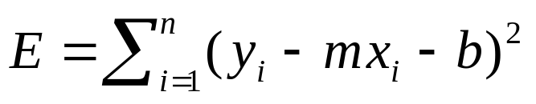
Line fitting
y=mx+b
Data: (x₁, y₁), …, (x_{n}, y_{n})
Line equation: y_{i} = m x_{i} + b
Find (m, b) to minimize
Minimize the fitting errors

Slide 7
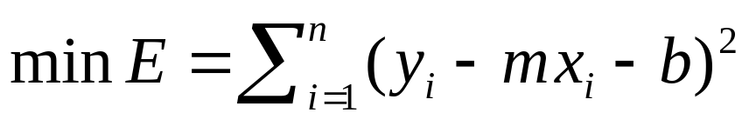
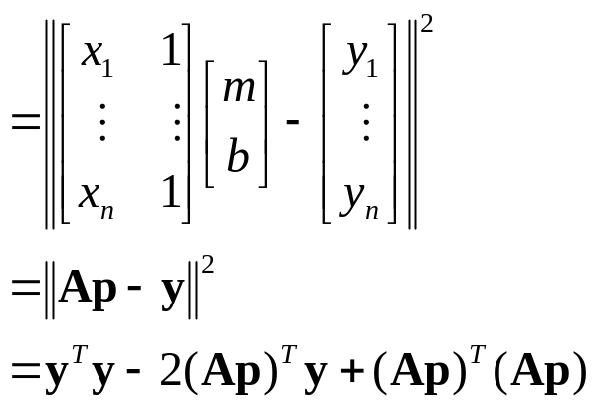
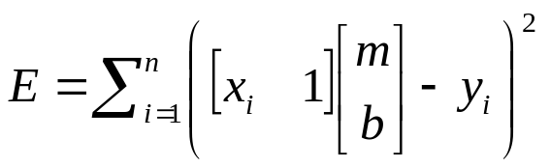
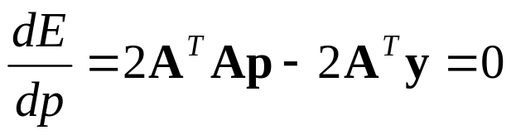
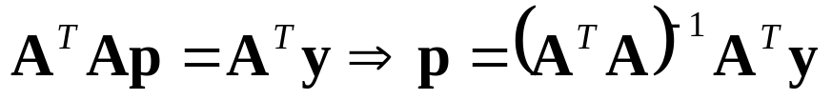
Line fitting
Matlab: p = A \ y;
Modified from S. Lazebnik

Slide 8
Least squares line fitting
Data: (x₁, y₁), …, (x_{n}, y_{n})
Line equation: y_{i} = m x_{i} + b
Find (m, b) to minimize
y=mx+b
(x_{i}, y_{i})

Slide 9
Problem with “vertical” least squares
Not rotation-invariant
Fails completely for vertical lines
Slide from S. Lazebnik

Slide 10
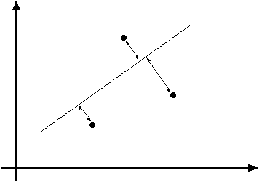

Total least squares
Slide modified from S. Lazebnik
If (a²+b²=1) then
Distance between point (x_{i}, y_{i}) is
|ax_{i} + by_{i} + c|
ax+by+c=0
Unit normal: N=(a, b)
(x_{i}, y_{i})
proof: http://mathworld.wolfram.com/Point-LineDistance2-Dimensional.html

Slide 11
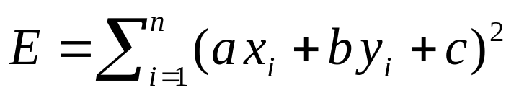
Total least squares
Slide modified from S. Lazebnik
If (a²+b²=1) then
Distance between point (x_{i}, y_{i}) is
|ax_{i} + by_{i} + c|
Find (a, b, c) to minimize the sum of squared perpendicular distances
ax+by+c=0
Unit normal: N=(a, b)
(x_{i}, y_{i})

Slide 12
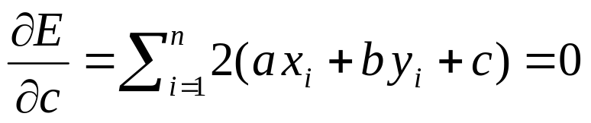
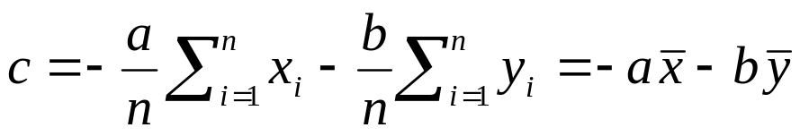
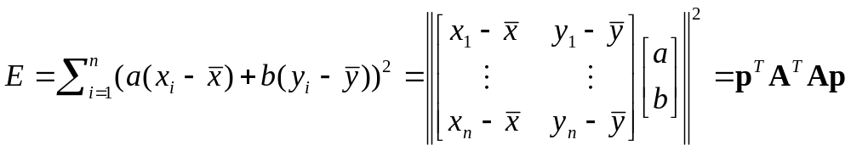
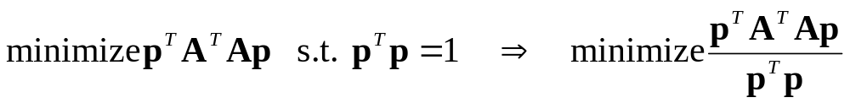
Total least squares
Slide modified from S. Lazebnik
Find (a, b, c) to minimize the sum of squared perpendicular distances
ax+by+c=0
Unit normal: N=(a, b)
(x_{i}, y_{i})
Solution is eigenvector corresponding to smallest eigenvalue of A^{T}A
See details on Raleigh Quotient: http://en.wikipedia.org/wiki/Rayleigh_quotient

Slide 13

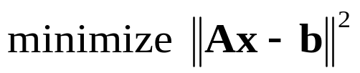




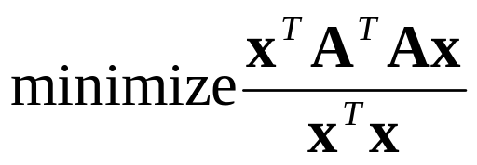
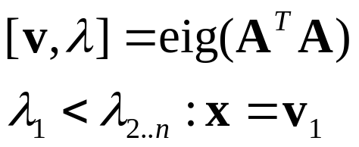
Recap: Two Common Optimization Problems
Problem statement
Solution
(matlab)
Problem statement
Solution

Slide 14
Least squares (global) optimization
Good
Clearly specified objective
Optimization is easy
Bad
May not be what you want to optimize
Sensitive to outliers
  Bad matches, extra points
Doesn’t allow you to get multiple good fits
  Detecting multiple objects, lines, etc.

Slide 15
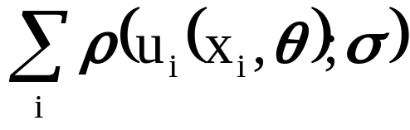


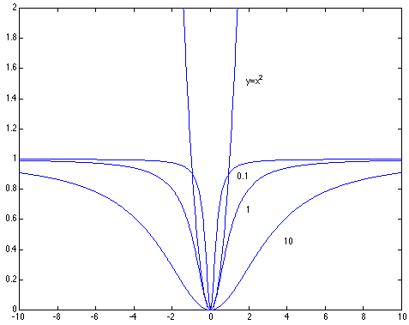
Robust least squares (to deal with outliers)
General approach:
minimize
u_{i} (x_{i}, θ) – residual of i^{th} point w.r.t. model parameters θ
ρ – robust function with scale parameter σ
The robust function ρ
Favors a configuration
with small residuals
Constant penalty for large residuals
Slide from S. Savarese

Slide 16
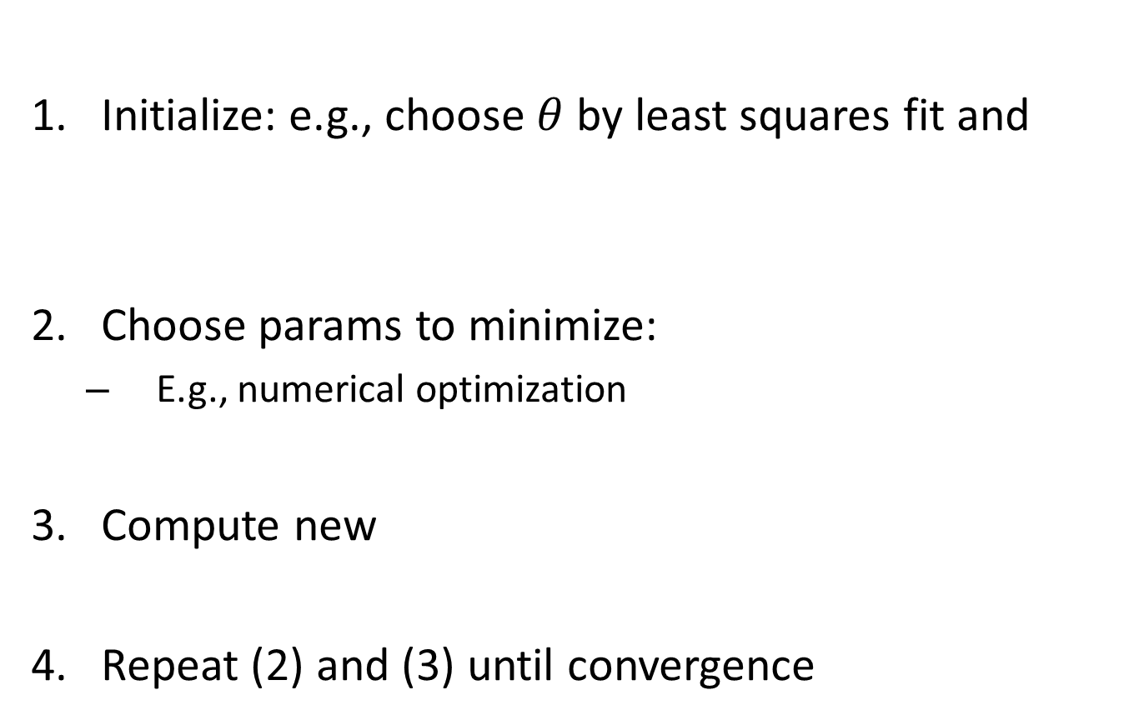
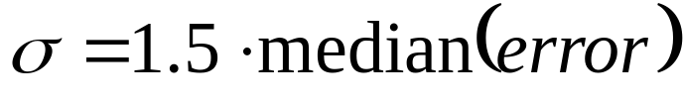
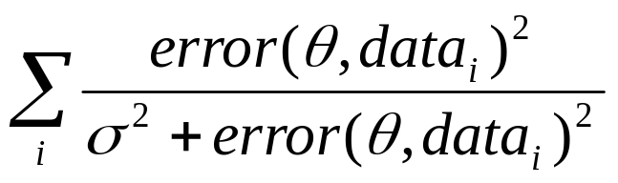
Robust Estimator

Slide 17
Other ways to search for parameters (for when no closed form solution exists)
Line search
  For each parameter, step through values and choose value that gives best fit
  Repeat (1) until no parameter changes
Grid search
  Propose several sets of parameters, evenly sampled in the joint set
  Choose best (or top few) and sample joint parameters around the current best; repeat
Gradient descent
  Provide initial position (e.g., random)
  Locally search for better parameters by following gradient

Slide 18
Hypothesize and test
Propose parameters
  Try all possible
  Each point votes for all consistent parameters
  Repeatedly sample enough points to solve for parameters
Score the given parameters
  Number of consistent points, possibly weighted by distance
Choose from among the set of parameters
  Global or local maximum of scores
Possibly refine parameters using inliers

Slide 19
Hough Transform: Outline
Create a grid of parameter values
Each point votes for a set of parameters, incrementing those values in grid
Find maximum or local maxima in grid

Slide 20
Task
Given a set of edge points, find the optimal straight line (minimal fitting error).

Slide 21


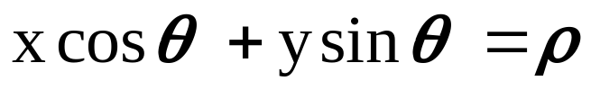
Review: Line Representation
y
y=mx+b
x
y
x
Notes:
polar representation

Slide 22
House Space
P.V.C. Hough, Machine Analysis of Bubble Chamber Pictures, Proc. Int. Conf. High Energy Accelerators and Instrumentation, 1959
y = m x + b
y
m
x
b
Image Space
Hough space
Every point in (m,b) corresponds to one line in (x,y);
Slide from S. Savarese
Notes:
􀁑 Basic ideas
• A line is represented as . Every line in the image corresponds
to a point in the parameter space
• Every point in the image domain corresponds to a line in the parameter
space (why ? Fix (x,y), (m,n) can change on the line . In other
words, for all the lines passing through (x,y) in the image space, their
parameters form a line in the parameter space)
• Points along a line in the space correspond to lines passing through the
same point in the parameter space (why ?)

Slide 23
House Space
y = m x + b
y
m
x
b
Image Space
Hough Space
Every point in (x,y) corresponds to one line in (m,b);
Notes:
􀁑 Basic ideas
• A line is represented as . Every line in the image corresponds
to a point in the parameter space
• Every point in the image domain corresponds to a line in the parameter
space (why ? Fix (x,y), (m,n) can change on the line . In other
words, for all the lines passing through (x,y) in the image space, their
parameters form a line in the parameter space)
• Points along a line in the space correspond to lines passing through the
same point in the parameter space (why ?)

Slide 24
Hough transform
y
m
x
b
y
m
3
5
3
3
2
2
3
7
11
10
4
3
2
3
1
4
5
2
2
1
0
1
3
3
x
b
Slide from S. Savarese
Notes:
􀁑 Basic ideas
• A line is represented as . Every line in the image corresponds
to a point in the parameter space
• Every point in the image domain corresponds to a line in the parameter
space (why ? Fix (x,y), (m,n) can change on the line . In other
words, for all the lines passing through (x,y) in the image space, their
parameters form a line in the parameter space)
• Points along a line in the space correspond to lines passing through the
same point in the parameter space (why ?)

Slide 25
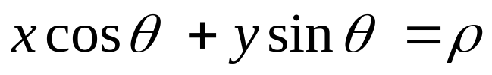
Hough transform
P.V.C. Hough, Machine Analysis of Bubble Chamber Pictures, Proc. Int. Conf. High Energy Accelerators and Instrumentation, 1959
Issue : parameter space [m,b] is unbounded…
Use a polar representation for the parameter space
y
x
Slide from S. Savarese
Notes:
􀁑 Basic ideas
• A line is represented as . Every line in the image corresponds
to a point in the parameter space
• Every point in the image domain corresponds to a line in the parameter
space (why ? Fix (x,y), (m,n) can change on the line . In other
words, for all the lines passing through (x,y) in the image space, their
parameters form a line in the parameter space)
• Points along a line in the space correspond to lines passing through the
same point in the parameter space (why ?)

Slide 26
Matlab Functions
BW=Edge(I, ‘canny’);
% house transform
[H,T,R] = hough (BW,'RhoResolution',0.5,'Theta',-90:0.5:89.5);
% find peaks
P = houghpeaks (H,5,'threshold',ceil(0.3*max(H(:))));
% for each peak, find the line
lines = Houghlines (BW,T,R,P,'FillGap',5,'MinLength',7);

Slide 27
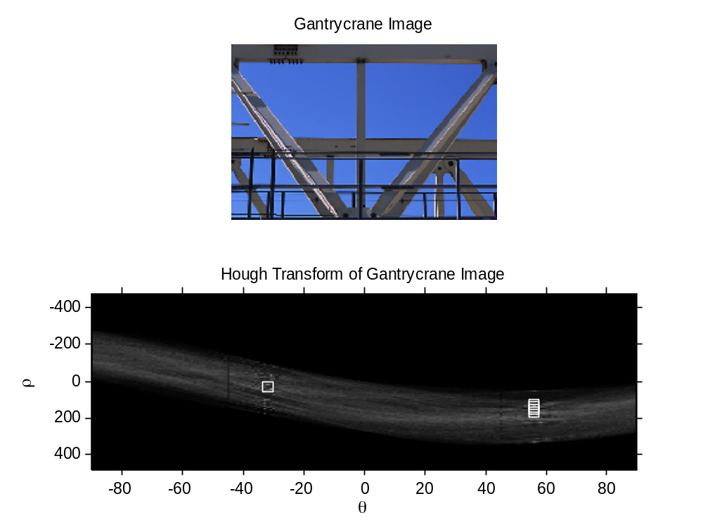
Matlab Functions
Demo_hough.m

Slide 28
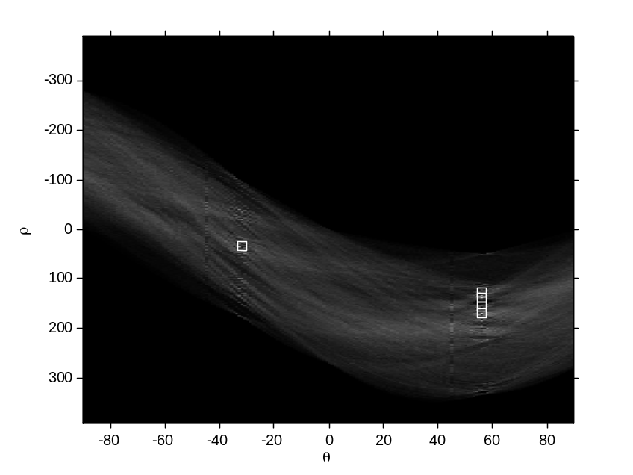
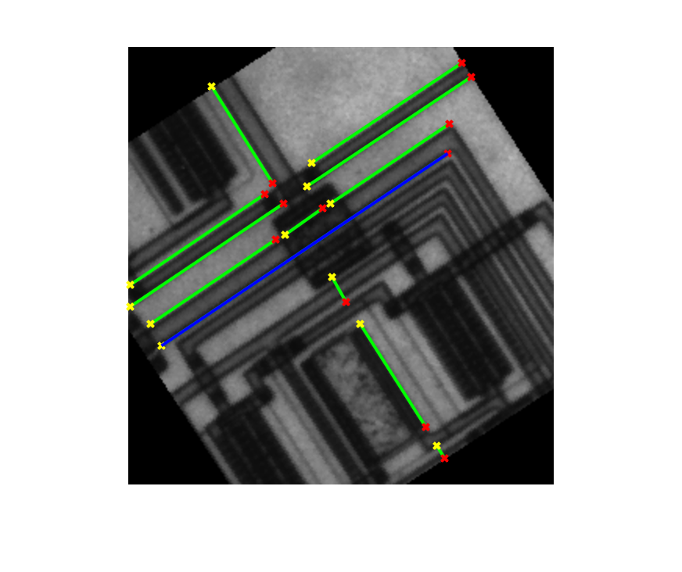
Matlab Functions
Demo_houghpeaks.m

Slide 29
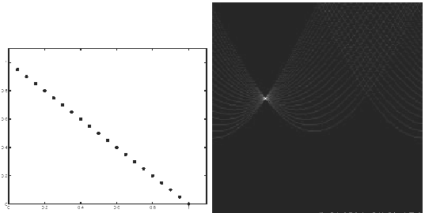
Hough transform - experiments
features
votes
Slide from S. Savarese
Notes:
Figure 15.1, top half. Note that most points in the vote array are very dark, because they
get only one vote.

Slide 30
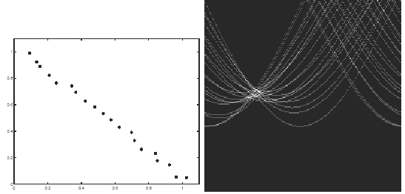
Hough transform - experiments
Noisy data
features
votes
Need to adjust grid size or smooth
Slide from S. Savarese
Notes:
This is 15.1 lower half

Slide 31
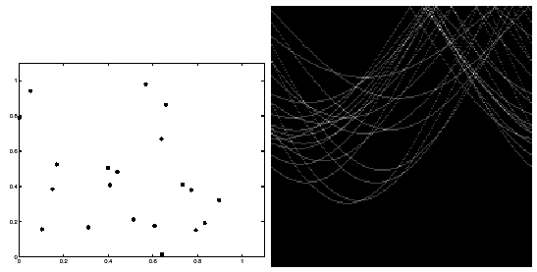
Hough transform - experiments
features
votes
Issue: spurious peaks due to uniform noise
Slide from S. Savarese
Notes:
15.2; main point is that lots of noise can lead to large peaks in the array

Slide 32
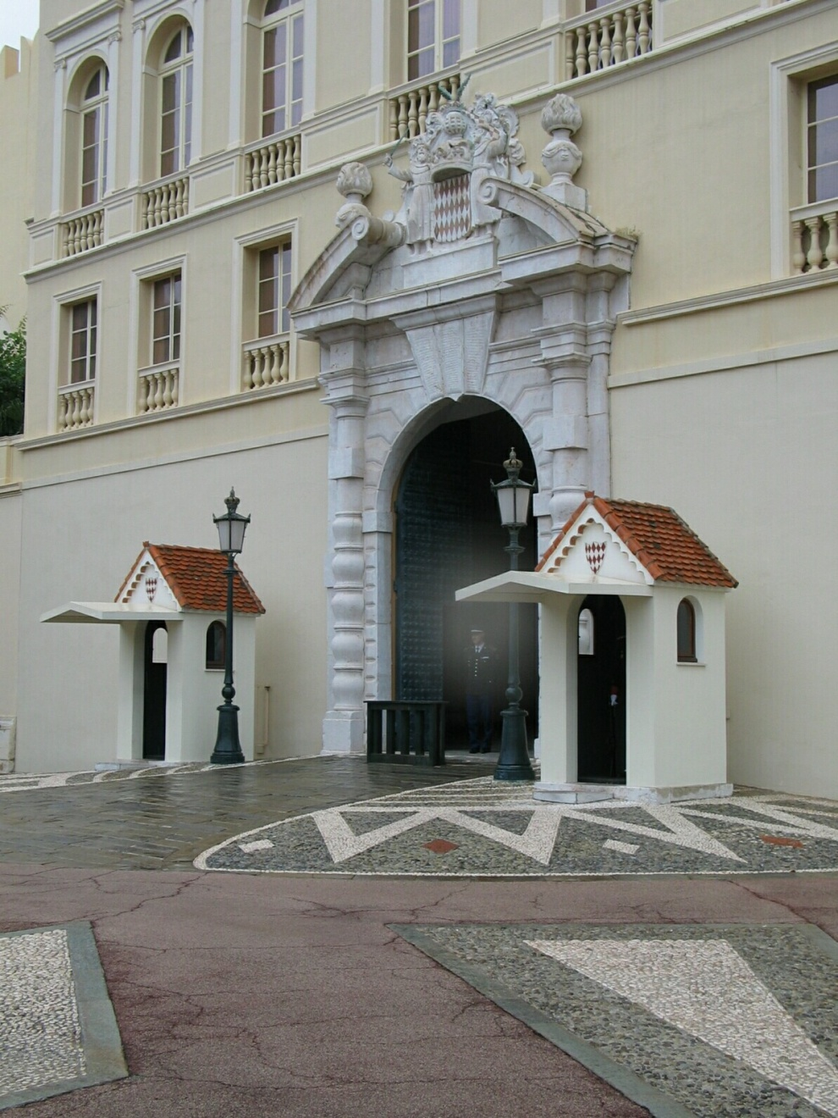
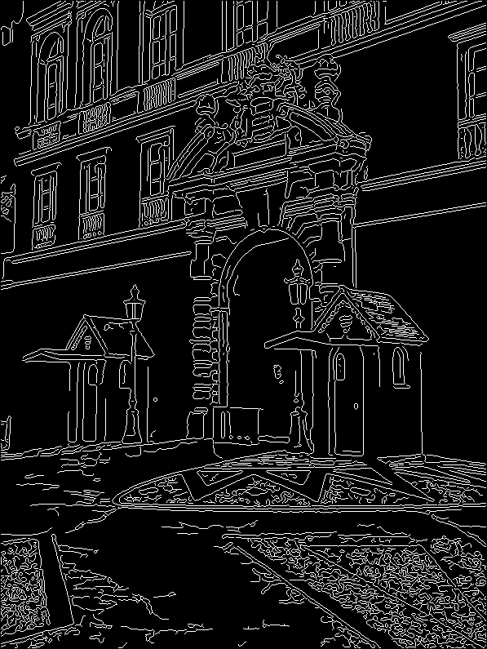
1. Image → Canny

Slide 33
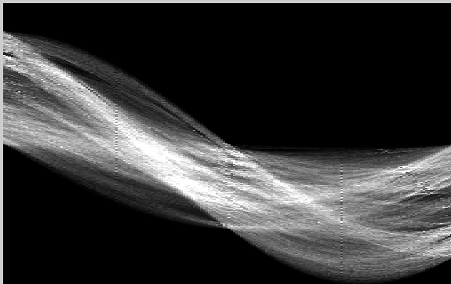
2. Canny → Hough votes

Slide 34
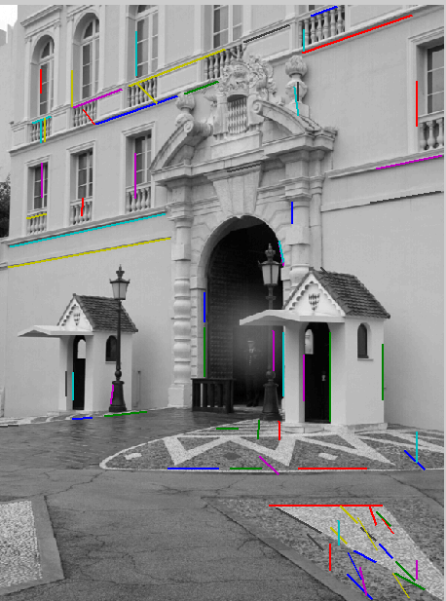
3. Hough votes → Edges
Find peaks and post-process

Slide 35
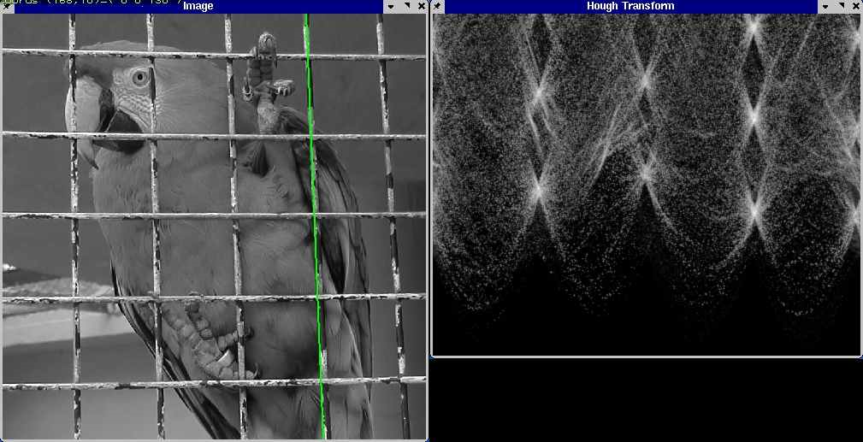
Hough transform example
http://ostatic.com/files/images/ss_hough.jpg

Slide 36
Summary
Line Fitting
  Least Square
Hough transform
  Straight line detection
  Curved line?
  3D Plane?

